Slide 1
The Best
Chinese Restaurants
In New York !
Using FourSquare API and KNN method to map
the most favorable dinning places in Chinatown
By MATT HAN LIU

Slide 2
1
Background

Slide 3
1
Background
New York attracts people from all over the world not only for its culture and fashion but also for variety of delicious food! When people especially the Chinese come to NY, the first place they will go might be Chinatown. If you want to taste Chinese food mixed with traditional and western taste, this is the place you must experience!
Among hundreds of Chinese restaurants in Chinatown, which of them worth trying? Let big data tell you!

Slide 4
2
Data

Slide 5
2
Data Source
In this case:
We use Foursuquare normal API (explore) to retrieve Chinese restaurants
‘Name’, ‘ID’, ‘Address’
2. By using each ‘ID’ we got, we use a premium API (venues detail) to retrieve its
‘Price_Tier’, ‘Likes_Count’, ‘Rating’, ‘Rating_Signals’,
‘Polular_Timeframe_Today’, ‘Latitude’, ‘Longitude’
By using each ‘ID’ we got, we use a premium API (tips) to retrieve their
‘Tips’, ‘Agree_Count’
4. For Chinatown location, we use ‘newyork_data.json’ provided by Coursera

Slide 6
2
How to use data
For recommendations on the map
‘Name’, ‘ID’, ‘Address’ will be used to build initial dataframe
‘Price_Tier’, ‘Likes_Count’, ‘Rating’, ‘Rating_Signals’, ‘Polular_Timeframe_Today’, ‘Tips’, ‘Agree_Count’ will be added into initial dataframe, we will show different color for different price tier on the map, and also in case people don’t want to go to one restaurant during busy timeframe, we will show ‘Polular_Timeframe_Today’ in the tooltip of each point on the map
3. ‘Latitude’, ‘Longitude’ will be used to point each location on the map
For KNN method
‘Name’, ‘ID’, ‘Address’, ‘Polular_Timeframe_Today’, ‘Tips’, ‘Agree_Count’ will be deleted and normalization will be provided.

Slide 7
3
Methodology

Slide 8
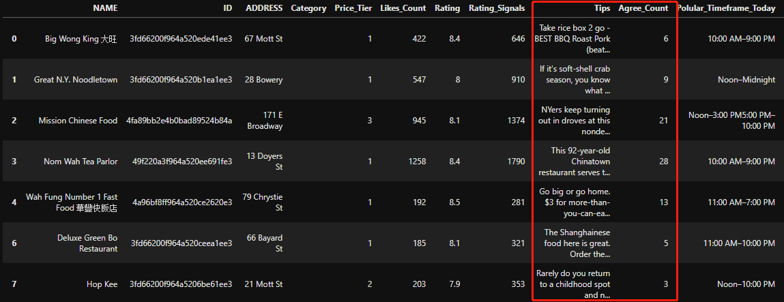
3
Methodology
We want to achieve three goals in the end:
A list with top 20 rating Chinese restaurants with most liked tip inside, so that we are able to know what attracts people the most in this restaurant.

Slide 9
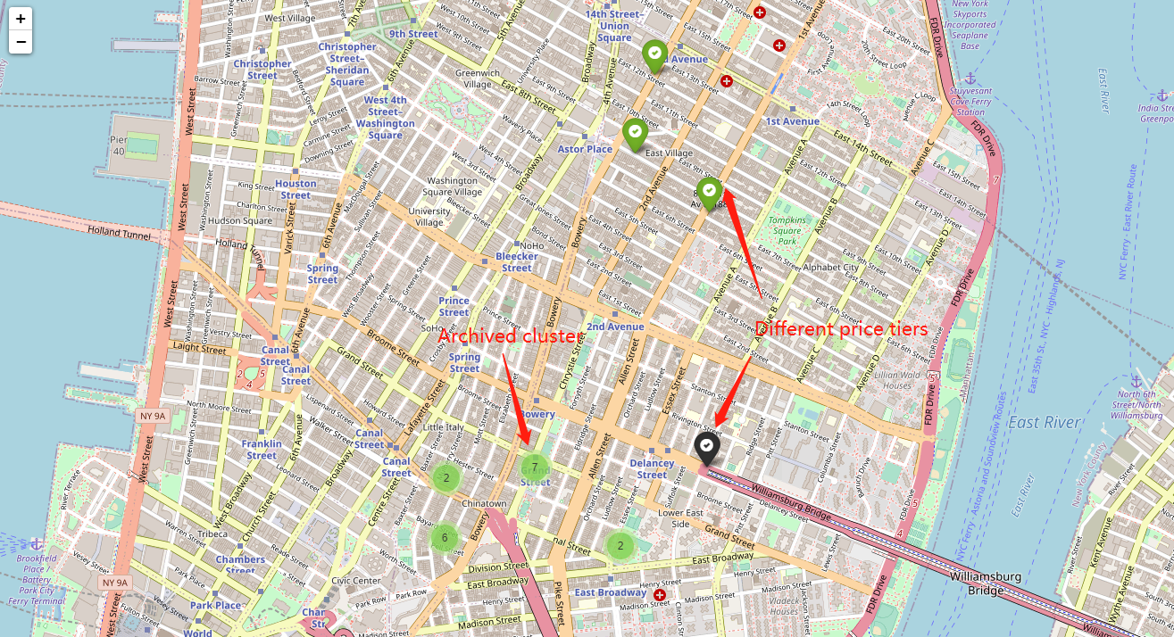
3
Methodology
A map showing top 20 choices in which:
Different colors represent different price tiers
If two or more places nearby, then automatically achieved into one cluster

Slide 10
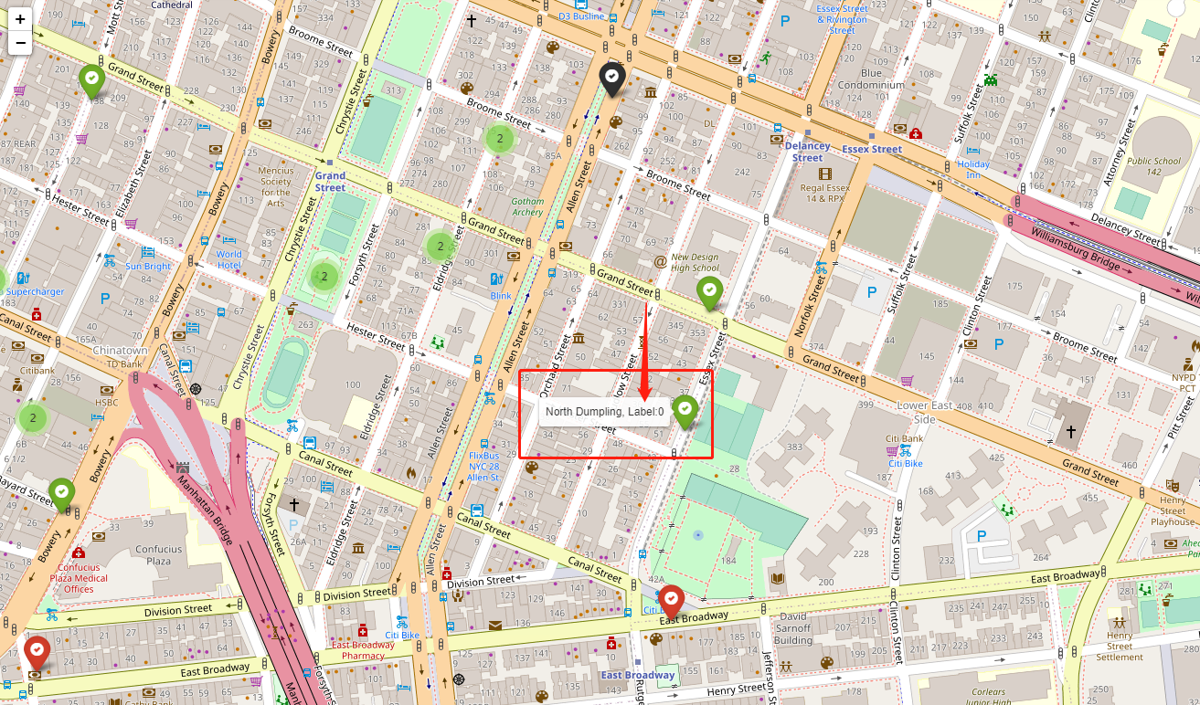
3
Methodology
A map similar to previous one but after KNN analysis :
Adding cluster label into the mouseover tooltip with different colors

Slide 11
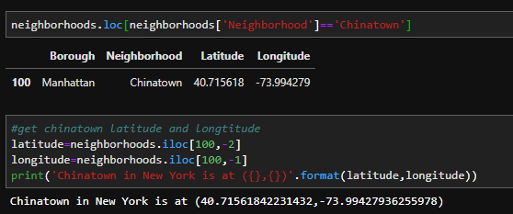
3
Methodology
In order to achieve the First Goal:
Import json to read newyork_data.json provided
Use for loop to add all Neighborhoods into dataframe we created
Use .loc to locate the latitude and longitude of Chinatown

Slide 12
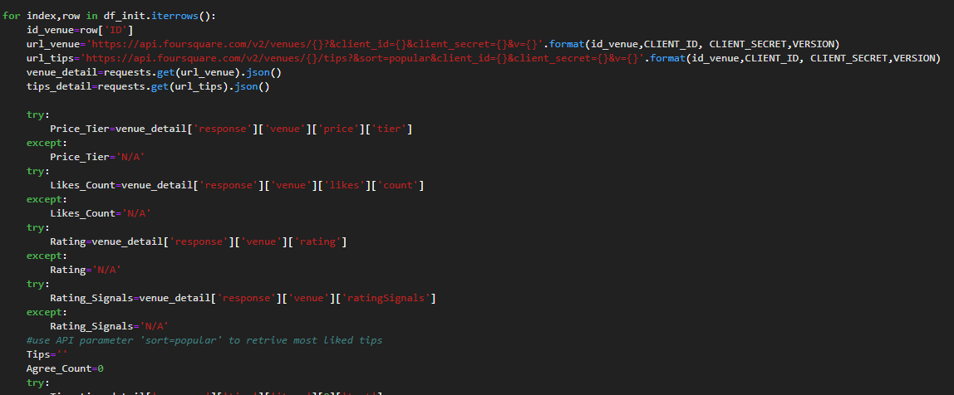
3
Methodology
Use requests.get(url).json() to retrieve Name, ID and Address from ‘explore’ endpoint of API
Use ID to retrieve rest parameters from ‘venue detail’ and ‘venue tips’ endpoints of API

Slide 13
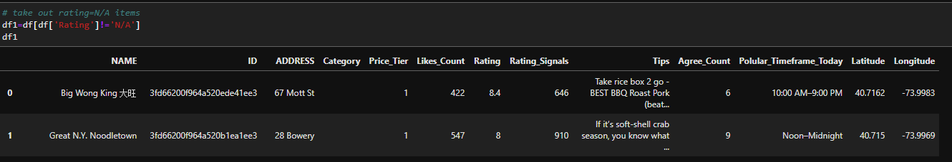
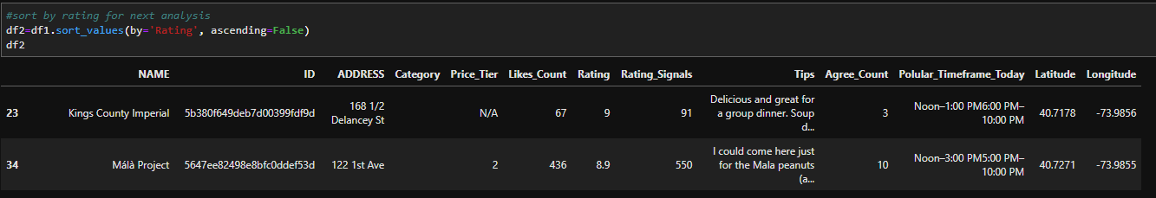
3
Methodology
In order to achieve the Second Goal:
We delete non rating ones and sort by rating then get top 20 Chinese restaurants

Slide 14
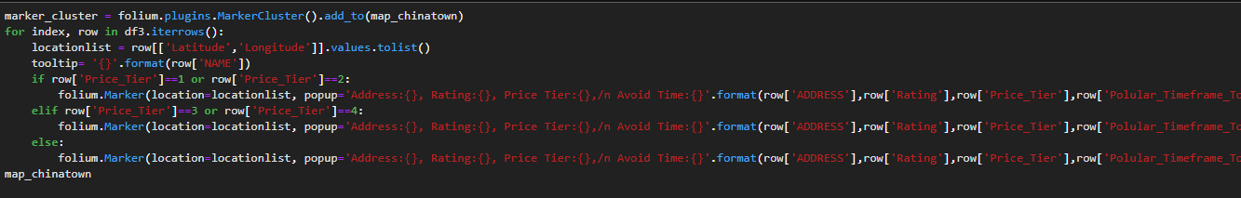
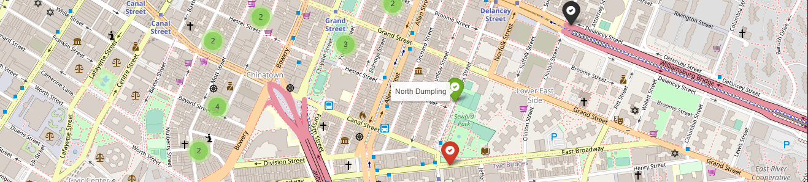
3
Methodology
Import folium to draw a NY map
From folium.plugins import MarkerCluster in order to gather nearby points into one cluster
We set up a rule to give different price tiers three colors, this can greatly help us identify price tiers without looking at words
Use tooltip to show names when mouseover

Slide 15
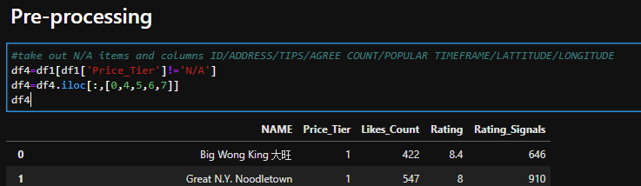
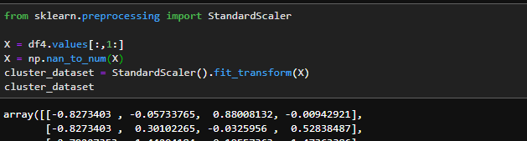
3
Methodology
In order to achieve the Third Goal:
Preprocessing by
(1) Take out items with N/A
(2) Standardize all columns

Slide 16
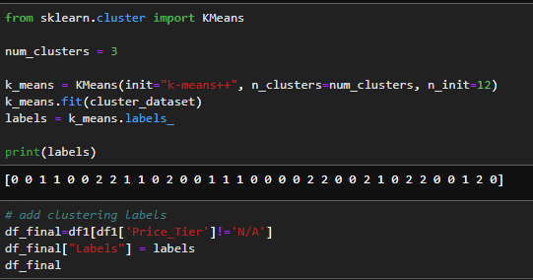
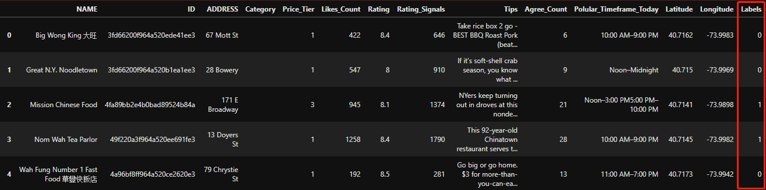
3
Methodology
Use KNN method to fit data, K=3
Add labels back to original dataframe

Slide 17
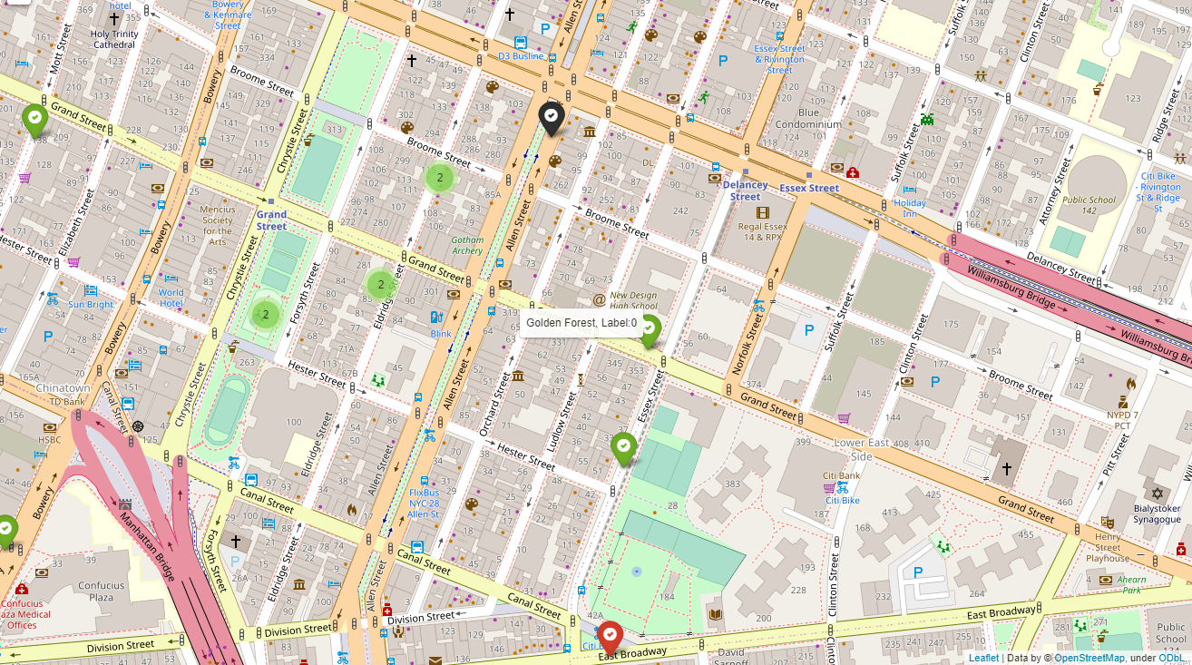
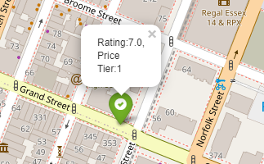
3
Methodology
Finally show on the map with labels on mouseover tooltips,
but remain the same info with previous map when you click the button

Slide 18
4
Results

Slide 19
4
Results
Most Chinese Restaurants’ratings are among 8.0 and 9.0
Taking 1st July 2020 as an example, the most common popular timeframes
are 10:00 AM–9:00 PM, meaning they are popular all day long
Most Chinese Restaurants 'prices are comfortable, price tiers from 1 to 2
Most of the top 20 places are within 10 mins walking distance

Slide 20
5
Discussion

Slide 21
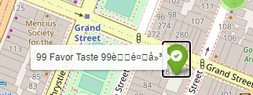
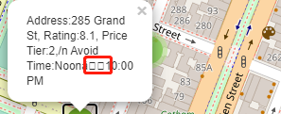
5
Discussion
Due to the limt of this API, we can only retrieve at most 100 records one time,
then after preprocessing, there will not be enough samples for KNN analysis
There are display problems of Chinese words or ‘-’ with folium map
For further development, we can consider get photos from API
and try to save on local notebook then insert them into map
There is display error on github for folium map,
now temporary solution is to use nbviewer.jupyter.org to preview

Slide 22
6
Conclusion

Slide 23
6
Conclusion
We successfully developed a one stop solution for new comers to New York
Trying to find the best Chinese restaurant in New York
We provide 3 ways to display, one is dataframe which can show most liked tips text,
one is a map showing different price tiers and ratings, one is similar map using
KNN analysis with 3 labels
For further development, we may need higher rank API developer account
to retrieve more records

Slide 24
THANK
YOU

